Slide 1

TASK 2
VULNERABILITIES

Slide 2
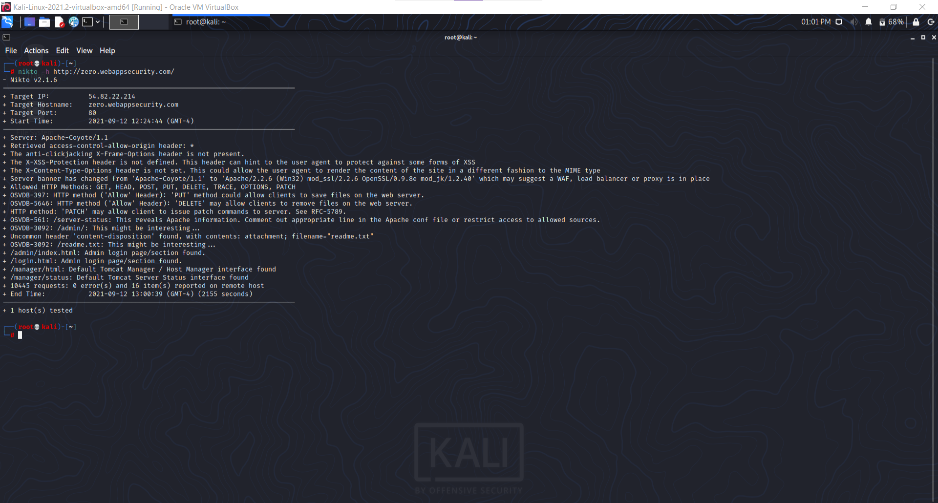
SCREENSHOT

Slide 3
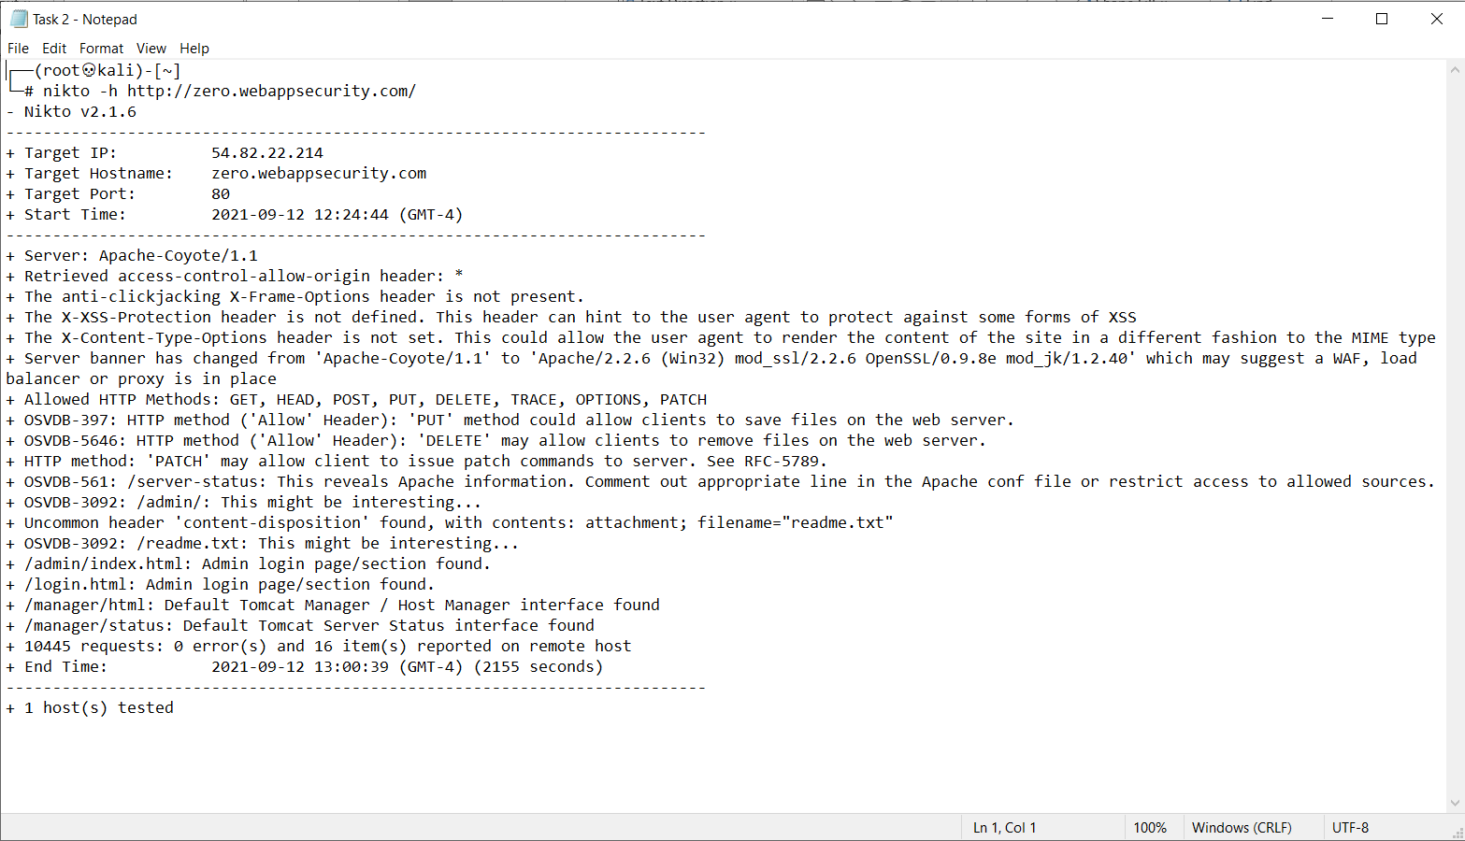
SCREENSHOT-2

Slide 4
REPORT-1
Title: Vulnerability testing
Domain: webappsecurity.com
Subdomain: zero.webappsecurity.com
**
**
Steps to reproduce:
Step 1: In the command prompt type the command 'nikto -h http://zero.webappsecurity.com/'
Step 2: Nikto starts scanning automatically.
Step 3: Choose any one of the reported Vulnerabilities.
Step 4: Write Reports for the vulnerability you wanted to write.
**
**

Slide 5
REPORT-2
Impacts:
1. It helps us to detect security weaknesses before malicious hackers do.
2. A list of all the vulnerabilities of the sub domain are showed in an orderly manner.
3. This can help us to prepare for future upgrades on the sub-domain.
4. It serves as an established security record for later assessments.
Mitigation:
1. If the vulnerabilities are noticed beforehand, we can lessen the likelihood and/or impact of a vulnerability being exploited.
2. This is sometimes necessary when a proper fix or patch isn't yet available for an identified vulnerability.
3. This option should ideally be used to buy time for an organization to eventually remediate a vulnerability.
4. Here, the anti-clickjacking X-Frame-Options header is not present, which could make the website vulnerable to clickjacking attack.
5. The X-XSS-Protection header is also not defined. This header can hint to the user agent to protect against some forms of XSS.
6. There are also some vulnerabilities that can allow the user to patch some files, delete some files or save some files directly to the server.
Including:
1. Screenshot
2. Text File

